Slide 1
COMP6940: BIG DATA AND DATA VISUALISATION
LECTURE #2: DATA COLLECTION AND EDA
Inzamam Rahaman

Slide 2
AGENDA
Data Collection
Methods – database, API, Web scraping
Advice for data cleaning
Exploratory Data Analysis
Useful strategies and techniques for EDA
Plots that are useful for EDA
TODAY’S LECTURE IS GOING TO BE FOCUSED ON CODE TO
IMPLEMENT THE ABOVE

Slide 3
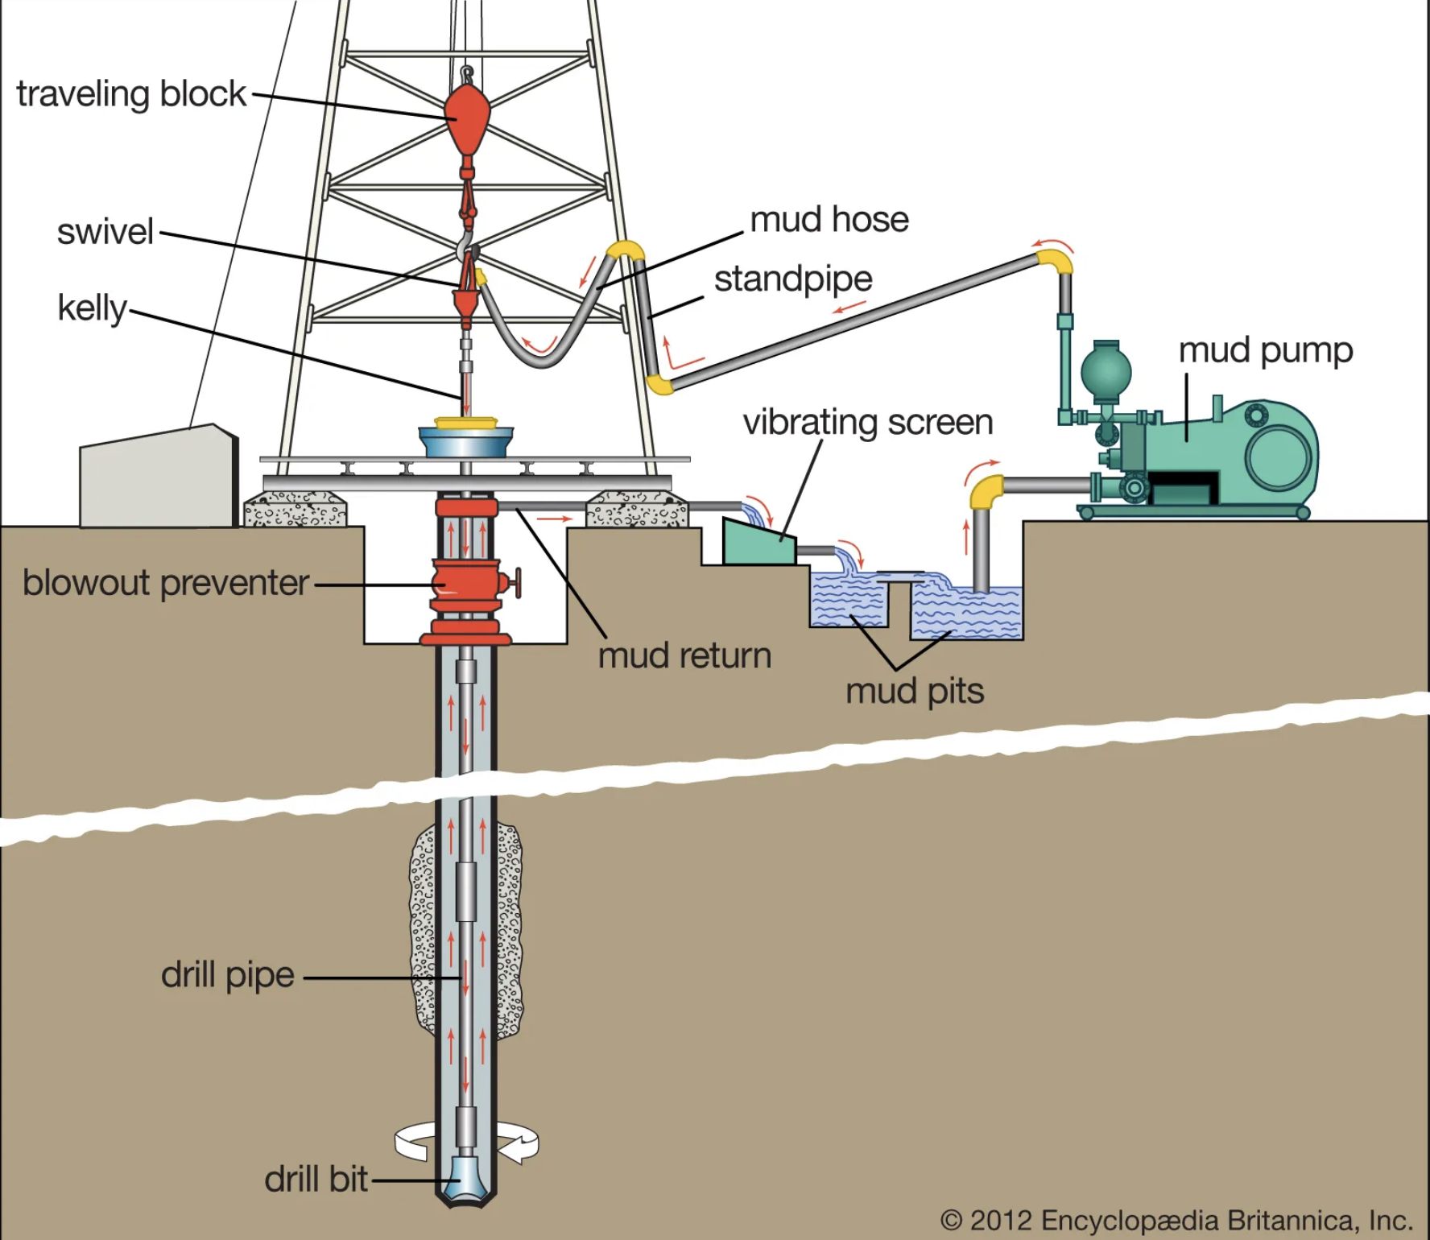
DATA COLLECTION
Just like petrochemicals, the first step in extracting value from data is extracting data from the “ground”
Typically, designing the ”wells” is not within the remit of the data scientist, but learning some additional database and software engineering might be useful
After the data has been extracted, it needs to undergo cleaning to enable further processing

Slide 4
DATA COLLECTION - METHODS
Data is housed in several formats and across different ”venues”
Each of these different venues has corresponding venues:
Machine-readable Flat files (e.g. CSVs, TSVs, .xlsx, JSON) – use the appropriate library (e.g. Pandas, Python JSON library) to read the file into the programme
Database or Data-warehouse (e.g. MySQL, SQLite, MongoDB, Snowflake) – use database connection library that allows for execution and retrieval of query results
Webservices – sometimes data is served by an API, e.g. USGS Earthquake data, Twitter API, that serves the data in a machine readable format, usually JSON
Website, PDF, or non machine-readable file – scraping (+ OCR). In Python BeautifulSoup + Selenium are good options
After collection, data must be massaged into appropriate format for downstream use

Slide 5
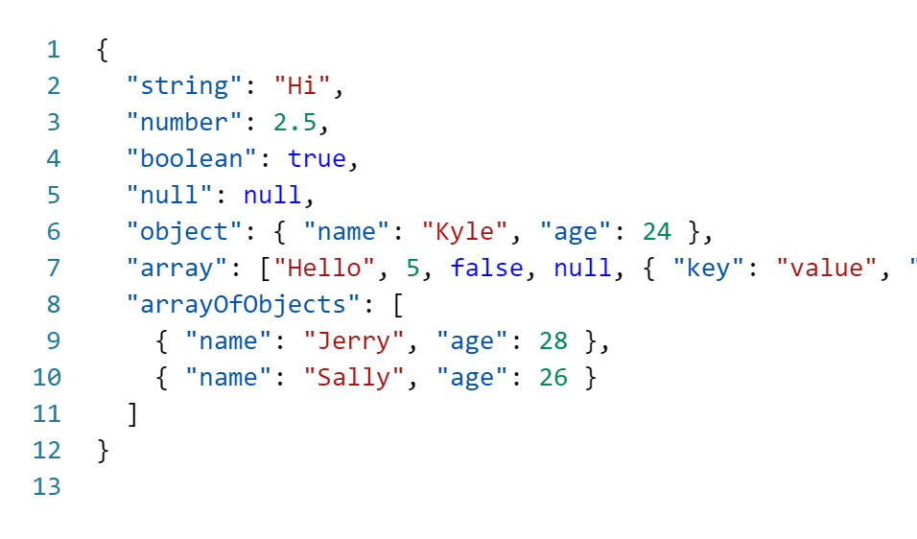
DATA COLLECTION - JSON
JSON – intialisation of JavaScript Object Notation
Used to represent objects in JavaScript programming language
It has evolved to become a cross-platform data exchange format
What XML was supposed to be, but a lot better
In Python, can use the integrated JSON library to process and use like a Python dictionary

Slide 6
DATA CLEANING
After data is collected, it must be cleaned
No magic recipe for cleaning data ☹
Some specific tooling is emerging, but is very incomplete
Cleaning data can take a lot of time (average of 60%)
Architectures exist for reducing effort in long-term by front-loading effort, e.g. layered data engineering pipelines
Things to look out for:
Typos and consistently spelled or encoded data (e.g. Y, yes, Yes all in the same column)
Incorrectly spelt names
Columns with all missing values or a single value for all rows
Inconsistent date formats (e.g. YYYYMMDD and MMDDYY in the same column) or erroneous dates (e.g. 20230231 or someone alive being born in 1756)
Missing values that can be sensibly imputed
Outliers that can be capped
Operate in goal-driven fashion: what changes to I need to make to my current data to enhance the correctness of my required downstream analysis?

Slide 7
DATA CLEANING
After data is collected, it must be cleaned
No magic recipe for cleaning data ☹
Cleaning data can take a lot of time (average of 60%)
Architectures exist for reducing effort in long-term by front-loading effort, e.g. layered data engineering pipelines
Things to look out for:
Typos and consistently spelled or encoded data (e.g. Y, yes, Yes all in the same column)
Incorrectly spelt names
Columns with all missing values or a single value for all rows
Inconsistent date formats (e.g. YYYYMMDD and MMDDYY in the same column) or erroneous dates (e.g. 20230231 or someone alive being born in 1756)
Missing values that can be sensibly imputed
Outliers that can be capped or removed
DO NOT TAKE THIS LIGHTLY – ALWAYS THINK ABOUT DOMAIN AND PURPOSE!!!!!

Slide 8
EXPLORATORY DATA ANALYSIS
Objective is to get high-level overview of data before further deeper analysis and plotting
Involves:
Simple plots (histograms, bar charts, pie charts, boxplots, scatterplots, line charts) to get overall trends and relationships
Counts and high-level aggregates (min, max, mode, median, mean, quartiles, std. dev, IQR, skewness, kurtosis) to intuit the distributions of columns
Correlation analysis to determine binary relationships between variables

Slide 9
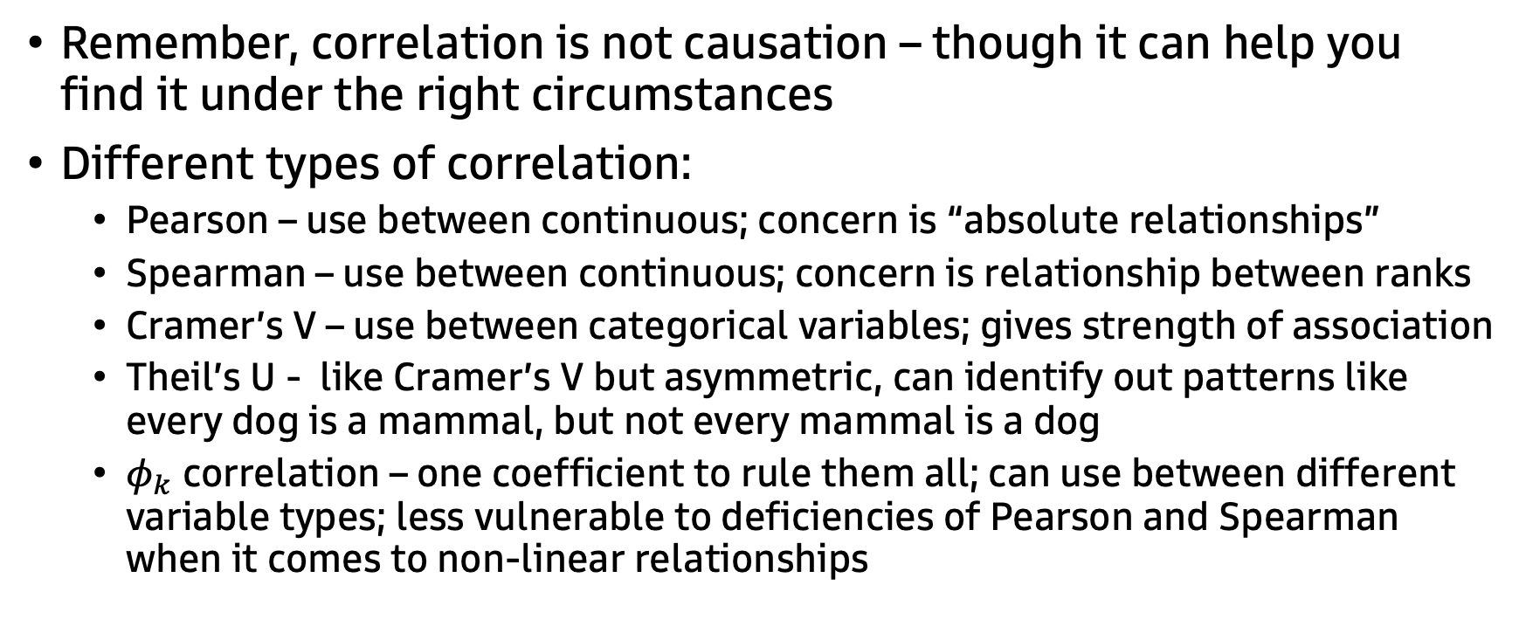
EXPLORATORY DATA ANALYSIS - CORRELATION
Remember, correlation is not causation – though it can help you find it under the right circumstances
Different types of correlation:
Pearson – use between continuous; concern is “absolute relationships”
Spearman – use between continuous; concern is relationship between ranks
Cramer’s V – use between categorical variables; gives strength of association
Theil’s U - like Cramer’s V but asymmetric, can identify out patterns like every dog is a mammal, but not every mammal is a dog
$φ_{k}$ correlation – one coefficient to rule them all; can use between different variable types; less vulnerable to deficiencies of Pearson and Spearman when it comes to non-linear relationships

Slide 10
QUESTIONS?

